Slide 1
Financial System & Managerial Finance
(BUS526)

Slide 2
About Resource Person
Khaled Bin Kamal
Corporate Professional & Independent Researcher
Emloyers so far:
Netle Bangladesh
Standard Chartered Bank
Nagad Limited
BRAC Bank Limited
Unique Group, DBL Group
Walton Hi-tech industries PLC
Academic Education:
Pursuing PhD in Finance in USM Malaysia
MBA from IBA , University of Dhaka
BBA from FBS , University of Dhaka
CERM(Certified Expert in Risk Mgt) from Frankfurt
school of finance & management, Germany
CFC(Certified Financial Consultant) from Institutie of
Financial Consultants, USA
Project Management
Business Process Review
Business Continuity Strategy
Corporate Branding
Corporate Communication
Audit & Assurance
Areas of expertise & experience:
Corporate governance
Corporate finance & treasury
Banking Risk Management
Enterprise Risk Management
Financial Crime Compliance
Regulatory Compliance

Slide 3
COURSE STRUCTURE
12 CLASSES
3 QUIZES (BEST 2)
MID TERM
ASSIGNMENT
TERM PAPER & PRESENTATION
CLASS PARTICIAPTION
FINAL EXAM

Slide 4
COURSE EVALUATION
Activities | % of the Total Assessment
Attendance | 5%
Quizzes (2 out of 3) | 10%
Assignments (Individual) | 5%
Group Term Paper | 15%
Mid-term Examintion | 25%
Final Examination | 40%
Total | 100%

Slide 5
COURSE OBJECTIVES
Explain major financial statements of businesses and the methods of fundamental analysis using financial ratios.
Describe the application of time value of money in financial management as well as in dealing with valuation problems of capital market securities.
Explain the mechanics of trading securities, the alternative marketplaces in which these various types of transactions take place, and the players who facilitate these deals.
Explain the assessment techniques and implications of risk-return trade-off in the investment process.
Help learners develop foundation knowledge on the valuation methods of various long-term capital market securities and determine the cost of capital of alternative financial sources.

Slide 6
COURSE TOPICS
Basic Finance Terms & Financial Institutions and Markets
Financial Statements, Cash Flows and Taxes
Evaluating a firm’s financial performance
Time Value of Money
Risk and Return
Bonds and Their Valuation
Stock Valuation
Cost of Capital
Capital Budgeting
Basics of Working Capital Management

Slide 7
COURSE LEARNING MATERIALS
Learning Materials:
Recommended Readings:
Fundamentals of Financial Management by Eugene F. Brigham and Joel F. Houston (15e)
Essentials of Managerial Finance by Scott Besley and Eugene F. Brigham (14e)
Principles of Managerial Finance by Lawrence J. Gitman & Chad J. Zutter (14e)
Others resources:
www.ft.com - Financial Times
www.wsj.com - The Wall Street Journal Online
www.economist.com – The Economist
www.bloomberg.com – Business and Markets news
www.dsebd.org – Dhaka Stock Exchange (DSE)
Financial press and financial pages of daily papers: “The Financial Express”, “The Businsess Standard”, “The Economist” and business sections of other international / local newspapers.

Slide 8

What is Finance?:
Money:
-medium of exchange
-barter system
-m1, m2, m3
-Fiat money
-emoney

Slide 9
What is Finance?:
“The system or study of creating, circulating and managing money” – Investopedia
“Finance is defined as the management of money and includes activities such as investing, borrowing, lending, budgeting, saving, and forecasting. There are three main types of finance: (1) personal, (2) corporate, and (3) public/government.”
– CFI (corporate finance institute)

Slide 10
What is Finance?:
“Finance is Procurement /sourcing of fund and utilization of that fund”.
Sourcing can be done from Surplus unit and utilization can be done to deficit unit; can be individual institute or government

Slide 11
What is Business Finance?:
“Finance is Procurement /sourcing of fund and utilization of that fund with a view to maximize wealth or profit or both”.

Slide 12
QUIZ TIME
Core activity of Finance:
1. Printing & Circulating Money
2. Management of money effectively
3. Creating, circulating and management of money
4. All of the above
Correct answer: 3.

Slide 13
Finance Vs Economics Vs Accounting?
Economics – Theoretical Study
"The Big Picture of the business environment”
Finance – Decision Making
“Management of money in business"
Accounting – Information System
The language of the business

Slide 14
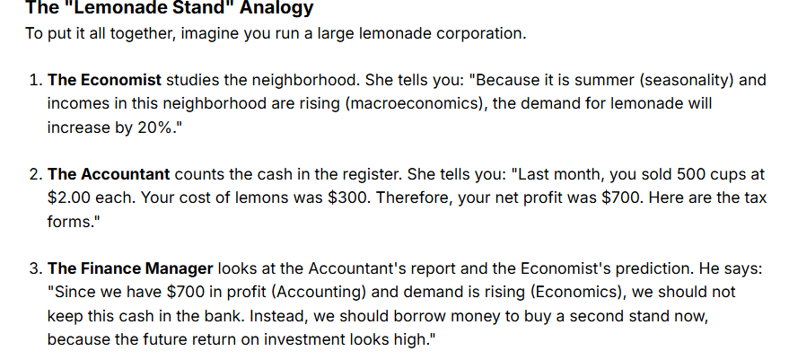
Finance Vs Economics Vs Accounting?

Slide 15
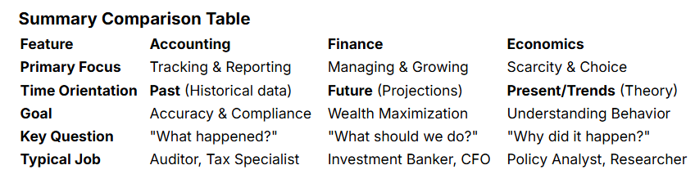
Finance Vs Economics Vs Accounting?

Slide 16
Opportunity Cost ?
Opportunity Cost is the value of the "Road Not Taken."
$$\text{Opportunity} \text{Cost}=\text{What} \text{you} \text{GAVE} \text{UP}−\text{What} \text{you} \text{GOT}$$

Slide 17
Asset ?
An asset is anything of value that is owned or controlled with the expectation that it will provide a benefit in the future.

Slide 18
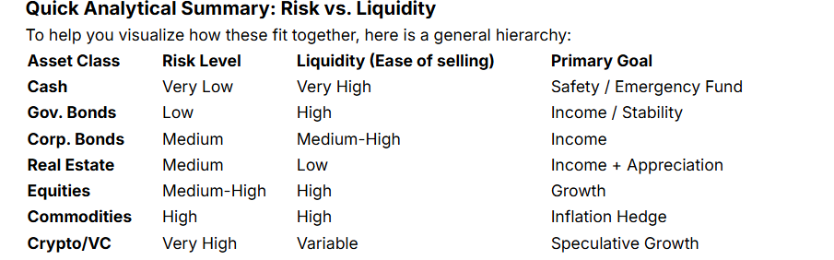
Asset Class?:

Slide 19
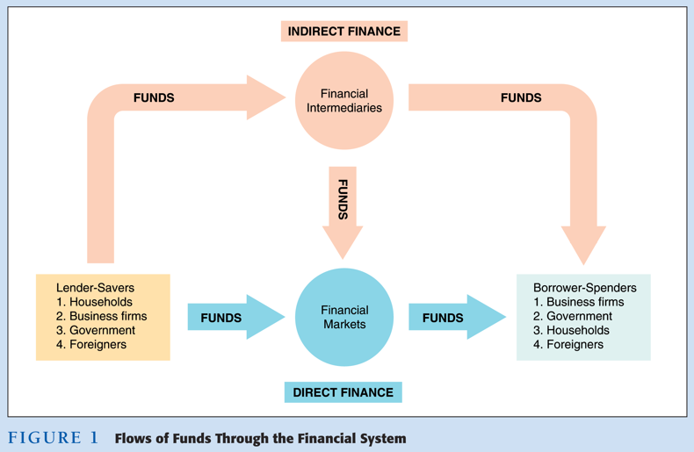
Financial System ?:

Slide 20
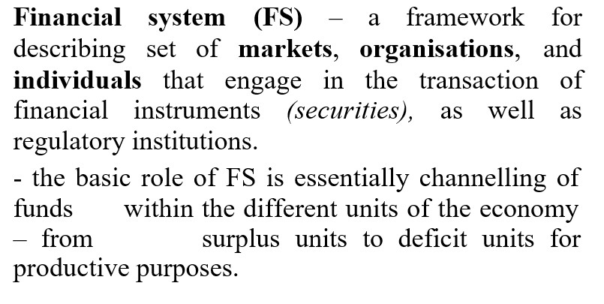
Financial System ?:

Slide 21
Financial System ?:
Financial markets perform the essential function of channeling funds from economic players that have saved surplus funds to those that have a shortage of funds

Slide 22
What’s your takeaway from this course?

Slide 23


Thank you
Q&A

